Slide 1
The MA in Hispanic Studies (MAHS) Is it for you?
Also presenting two NEW options: Accelerated BA/BS-MA Dual Master’s Degrees

Slide 2
The MAHS: A Brief History
Distance Education:
ECU first UNC university to offer degrees on line. Offers more DE courses than anyone. The Hispanic Studies program has been offering courses entirely DE since 1997! We bring education to the people. We are here for working people with families.
Engaged Learning:
ECU is a Carnegie Engaged Institution. Hispanic Studies has been successfully offering undergraduate internship opportunities for 25 years!
Educating Educators:
ECU was founded as East Carolina Teachers College. Our Hispanic Studies program has graduated more of North Carolina’s K-12 Spanish teachers than any other UNC school!
Cultural Studies: Language, literature and the arts reflect the world view of a time, place, and people
The Beginning:
Who are we and what do we do best?

Slide 3
WHO may be interested?
K-12 educators interested in improving their language skills and learning of teaching innovations and discovering new content, and maintaining licensure
Professionals in fields such as health, social work and business who wish to improve their language skills and cultural competence to better compete, or to better serve their clientele
Those interested in pursuing a Ph.D. in linguistics or literature, or in teaching at the post-secondary level

Slide 4
WHY ECU? What makes our program unique…
Learn by doing: ours is the only MA in Hispanic Studies program that offers an engaged research experience. Upon acceptance into our program, we will work with you to find a placement with one of our many partners statewide, one that agrees with your interests and professional goals. You will also have the opportunity to devise a research project based on that experience!
Access: There for you...wherever you are! Courses will be offered online as well as face-to-face on a schedule friendly to working people.
Not your typical curriculum: our distinctive curriculum is not divided into traditional language / culture / literature courses but takes a holistic approach.

Slide 5
Building on our strengths: ENGAGEMENT SPAN 6003 Applied Research Methods SPAN 6004 Engaged Field Work SPAN 6070 Engaged Research Experience
Vidant Health Care | Latino Commission on AIDS | Pathways to Life Mental Health Services
Association of Mexicans in North Carolina | Hispanic Community Center in Goldsboro | Centro Latino of Catawba County
Greene County Health Care | Student Action with Farm Workers | East Coast Migrant Head Start Project

Slide 6
You could even do an engaged research project on the job!
For K-12 Educators, this could be done in the Summer, or as part of what you already do as K-12 educators, as a class-based project.
Also for educators: SPAN 6600 - Recent Trends in Foreign Language Teaching, Learning, and Acquisition

Slide 7
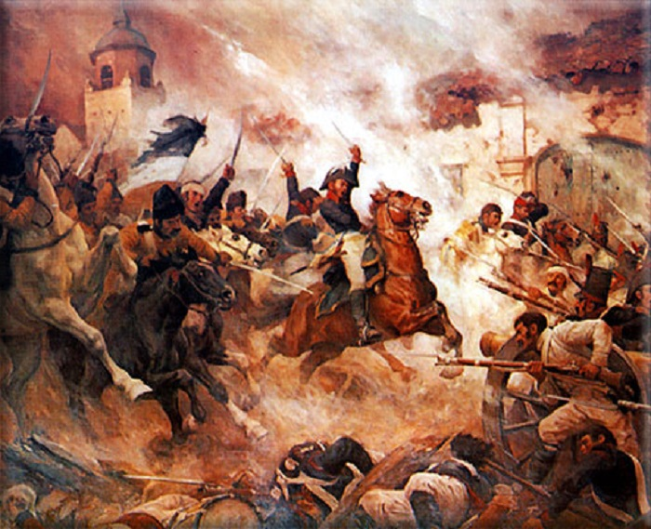
History, literature, film, arts….
SPAN 6002 Humanities Research Methods
SPAN 6010 Hispanic Cultural Studies
SPAN 6020 Contemporary Issues of the Hispanic World
SPAN 6040 Topics in Hispanic Studies

Slide 8
Language in context: The science of language The uses of language
SPAN 6040 Current Trends in Hispanic Linguistics
SPAN 6050 Professional Literacies

Slide 9
Our first four graduates’ MA research projects reflect the possibilities we offer….
Contexto Familiar y Expectativas Universitarias de los Estudiantes Latinos en Los condados de Pitt y Lenoir: un Estudio de Métodos Mixtos
“La ironia del imago lazari: Las sutilezas de Pérez Galdós en La Fontana de Oro”
“Reducir las barreras y riesgos de trastornos mentales dentro de la comunidad latina: una guía enfocada en aspectos culturales y sociales de la cultura latina”
“Desterritorialización, transnacionalismo y re-espacialización de la música regional mexicana en los Estados Unidos”

Slide 10
Accelerated Bachelor of Arts in Foreign Languages and Literatures/Master of Arts in Hispanic Studies
WHO?
Junior majors in Hispanic studies or Hispanic studies education (72 s.h.)
Minimum GPA of 3.5 in SPAN courses and 3.0 overall.
WHAT?
Finish BA and MA in 5 yrs
Count up to 12 s.h. toward both BA and MA
WHEN?
Senior year (90 undergraduate semester hours; 120 s.h. required for BA).
HOW?
Contact the Program Director, Dr. Almitra Medina, medinaa15@ecu.edu
For more information: http://catalog.ecu.edu/preview_program.php?catoid=21&poid=5677&returnto=1876

Slide 11
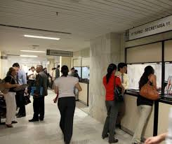
Individual Dual Master’s Degrees: 2 degrees in 3 years!
Individualized dual degree programs combine linguistic and cultural competence with another professional field; for example, in the health sciences, social work or business.
UP TO 30% of credit hours may be shared between the two degrees—saving you time and money!

Slide 12
Admissions requirements
Baccalaureate degree from an accredited institution, not necessarily in the field if language skills are adequate (minimum requirement)
Undergraduate GPA of 3.0 (general), 2.5 (minimum for provisional acceptance)
Evidence of sufficient language skills in Spanish in an oral interview and writing sample.
NO GRE or other exam required!
If English is not the applicant’s native language and they have not completed at least 18 credit hours at a United States school, they must achieve the minimum score required by the Graduate School on the TOEFL, IELTS, or PTE, or complete the ECU Language Academy (ECULA).

Slide 13
Documents to be submitted for admission
Completed application form
Application fee
Three letters of recommendation
A writing sample (in Spanish). May be an undergraduate term paper, or a 500-word essay on why you wish to pursue an MA and how it fits in to your professional plans
Official transcripts are required for all earned degrees (undergraduate and graduate) and for all institutions attended in the most recent five years
If English is not the applicant’s native language and they have not completed at least 18 credit hours at a United States school, or completed the ECU Language Academy (ECULA), they must have official TOEFL, IELTS, or PTE test score reports sent

Slide 14
Interested? Contact Dr. Almitra Medina medinaa15@ecu.edu 252-328-2104
THANK YOU!

